Slide 1

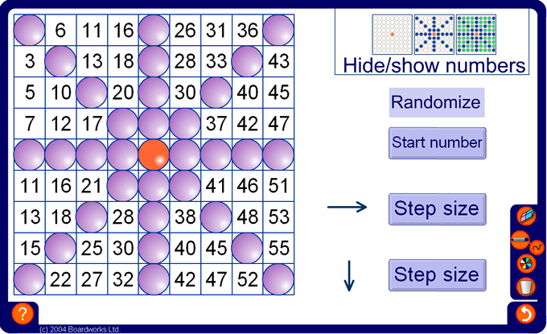



Sequence grid
Notes:
Start the activity by asking pupils to work out the number that is hidden by the orange counter.
Initially, do not tell pupils how the numbers in the grid have been generated.
Ask pupils if they can see any patterns.
The numbers in the rows, columns and diagonals form arithmetic sequences. Pupils will need to determine the rule for two of these sequences by subtracting numbers in adjacent squares (either horizontally, vertically or diagonally) and counting on.
You may click on any counter at any time to reveal the number beneath it.
As an extension or homework activity ask pupils to fill in their own sequence grids. They can generate the table by choosing one rule for the rows and another for the columns. They can then investigate how the sequences in the diagonals are related to the sequences in the rows and columns.

